Slide 1
Word representation
Đào Việt Duy – 51603070
Nguyễn Duy Hàn Lâm – 196005004
Instructor: Thầy Lê Anh Cường

Slide 2
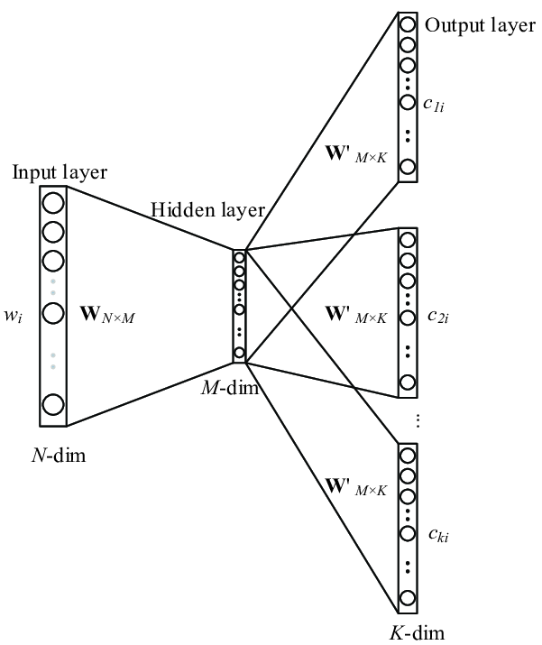
Skip-gram
Từ ngữ cảnh
Từ trung tâm
Từ ngữ cảnh
Từ ngữ cảnh

Slide 3
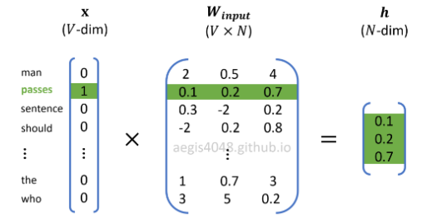
Skip-gram (Feedforward)

Slide 4
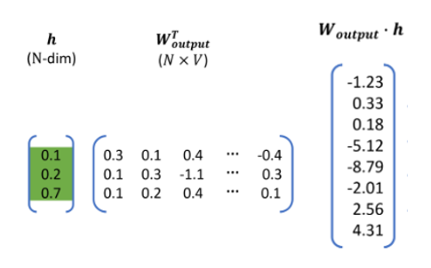
Skip-gram (Feedforward)

Slide 5
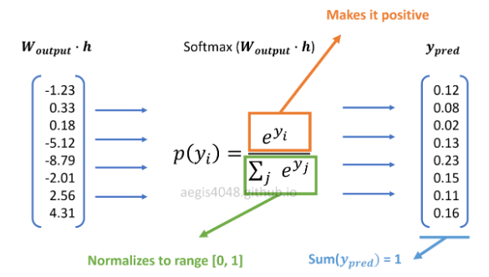
Skip-gram (Feedforward)

Slide 6
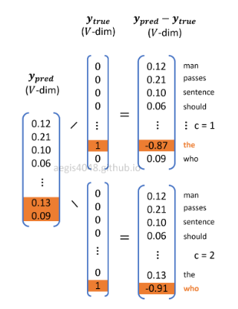

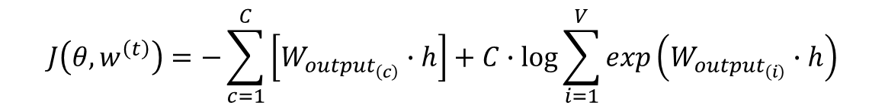
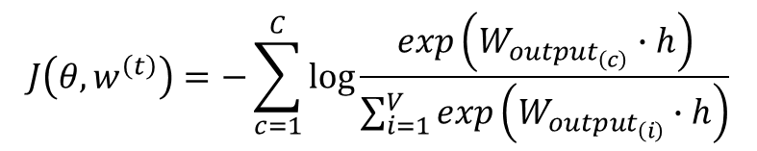
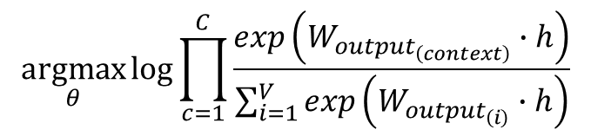
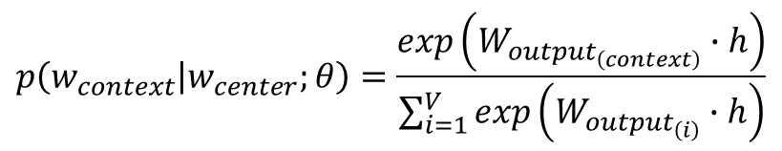
Skip-gram (Feedforward)
$$\underset{θ}{argmax}{\log{p\left(w_{1},w_{2},…,w_{C} | w_{center};θ\right)}}$$
$$p\left(w_{context} | w_{center};θ\right)=\frac{exp\left(W_{{output}_{\left(context\right)}}∙h\right)}{\sum_{i=1}^{V}{exp\left(W_{{output}_{\left(i\right)}}∙h\right)}}$$
$$\underset{θ}{argmax}{\log{\prod_{c=1}^{C}{\frac{exp\left(W_{{output}_{\left(context\right)}}∙h\right)}{\sum_{i=1}^{V}{exp\left(W_{{output}_{\left(i\right)}}∙h\right)}}}}}$$
$$J\left(θ,w^{\left(t\right)}\right)=−\sum_{c=1}^{C}{\log{\frac{exp\left(W_{{output}_{\left(c\right)}}∙h\right)}{\sum_{i=1}^{V}{exp\left(W_{{output}_{\left(i\right)}}∙h\right)}}}}$$
$$J\left(θ,w^{\left(t\right)}\right)=−\sum_{c=1}^{C}{\left[W_{{output}_{\left(c\right)}}∙h\right]}+C∙\log{\sum_{i=1}^{V}{exp\left(W_{{output}_{\left(i\right)}}∙h\right)}}$$

Slide 7
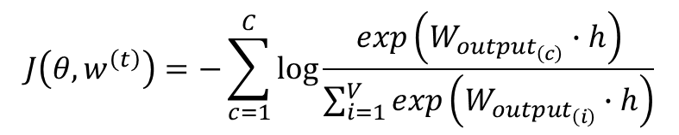
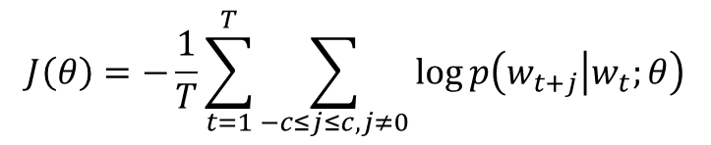
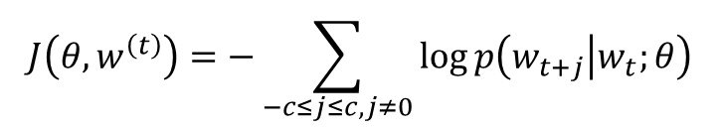
Skip-gram (Feedforward)
$$J\left(θ,w^{\left(t\right)}\right)=−\sum_{c=1}^{C}{\log{\frac{exp\left(W_{{output}_{\left(c\right)}}∙h\right)}{\sum_{i=1}^{V}{exp\left(W_{{output}_{\left(i\right)}}∙h\right)}}}}$$
$$J\left(θ,w^{\left(t\right)}\right)=−\sum_{−c≤j≤c,j≠0}{\log{p\left(w_{t+j} | w_{t};θ\right)}}$$
Tổng quát hóa cho T từ:
$$J\left(θ\right)=−\frac{1}{T}\sum_{t=1}^{T}{\sum_{−c≤j≤c,j≠0}{\log{p\left(w_{t+j} | w_{t};θ\right)}}}$$

Slide 8
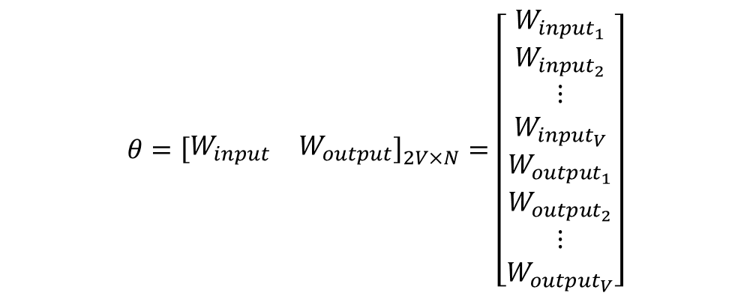
Skip-gram (Backpropagation)
$$θ={\left[\begin{matrix}W_{input} & W_{output}\end{matrix}\right]}_{2V×N}=\left[\begin{matrix}\begin{matrix}W_{{input}_{1}} \\ W_{{input}_{2}}\end{matrix} \\ \begin{matrix}⋮ \\ W_{{input}_{V}}\end{matrix} \\ \begin{matrix}W_{{output}_{1}} \\ W_{{output}_{2}} \\ \begin{matrix}⋮ \\ W_{{output}_{V}}\end{matrix}\end{matrix}\end{matrix}\right]$$

Slide 9
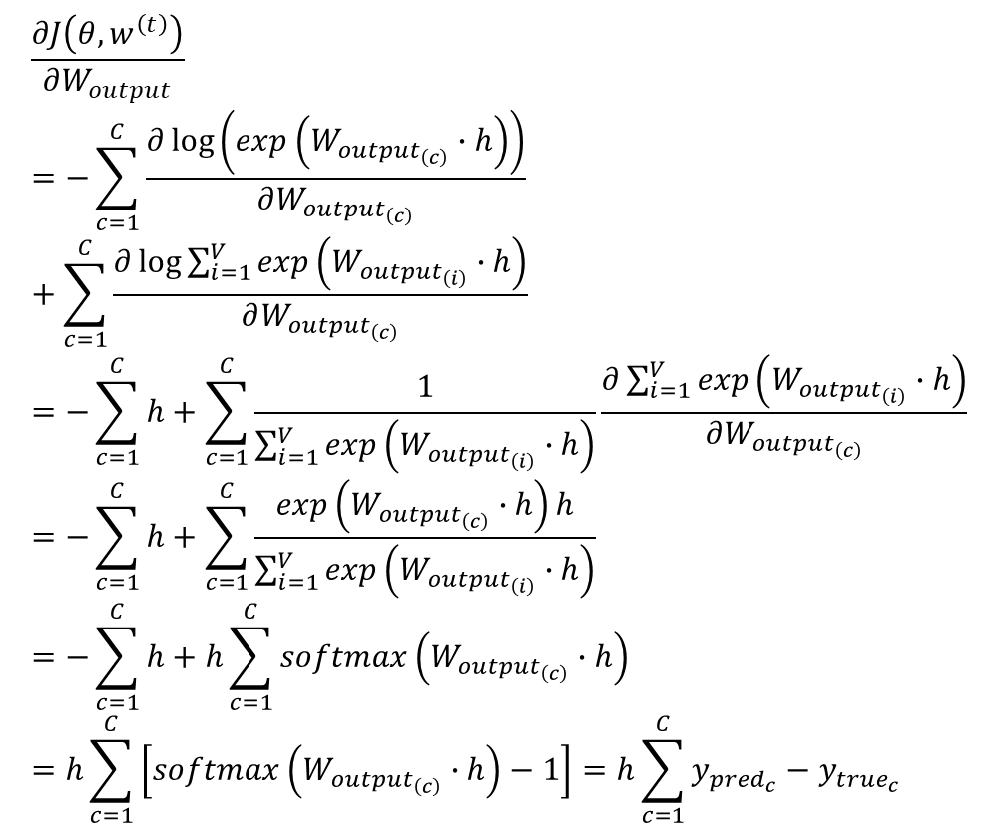
Skip-gram (Backpropagation)
$$\frac{∂J\left(θ,w^{\left(t\right)}\right)}{∂W_{output}}=−\sum_{c=1}^{C}{\frac{∂\log\left(exp\left(W_{{output}_{\left(c\right)}}∙h\right)\right)}{∂W_{{output}_{\left(c\right)}}}}+\sum_{c=1}^{C}{\frac{∂\log{\sum_{i=1}^{V}{exp\left(W_{{output}_{\left(i\right)}}∙h\right)}}}{∂W_{{output}_{\left(c\right)}}}}=−\sum_{c=1}^{C}{h}+\sum_{c=1}^{C}{\frac{1}{\sum_{i=1}^{V}{exp\left(W_{{output}_{\left(i\right)}}∙h\right)}}\frac{∂\sum_{i=1}^{V}{exp\left(W_{{output}_{\left(i\right)}}∙h\right)}}{∂W_{{output}_{\left(c\right)}}}}=−\sum_{c=1}^{C}{h}+\sum_{c=1}^{C}{\frac{exp\left(W_{{output}_{\left(c\right)}}∙h\right)h}{\sum_{i=1}^{V}{exp\left(W_{{output}_{\left(i\right)}}∙h\right)}}}=−\sum_{c=1}^{C}{h}+h\sum_{c=1}^{C}{softmax\left(W_{{output}_{\left(c\right)}}∙h\right)}=h\sum_{c=1}^{C}{\left[softmax\left(W_{{output}_{\left(c\right)}}∙h\right)−1\right]}=h\sum_{c=1}^{C}{y_{{pred}_{c}}−y_{{true}_{c}}}$$

Slide 10
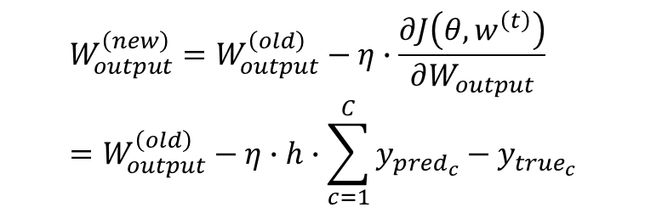
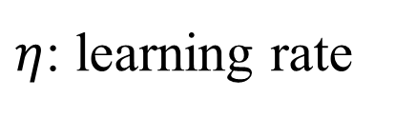
Skip-gram (Backpropagation)
$η$: learning rate
$$W_{output}^{\left(new\right)}=W_{output}^{\left(old\right)}−η∙\frac{∂J\left(θ,w^{\left(t\right)}\right)}{∂W_{output}}=W_{output}^{\left(old\right)}−η∙h∙\sum_{c=1}^{C}{y_{{pred}_{c}}−y_{{true}_{c}}}$$

Slide 11
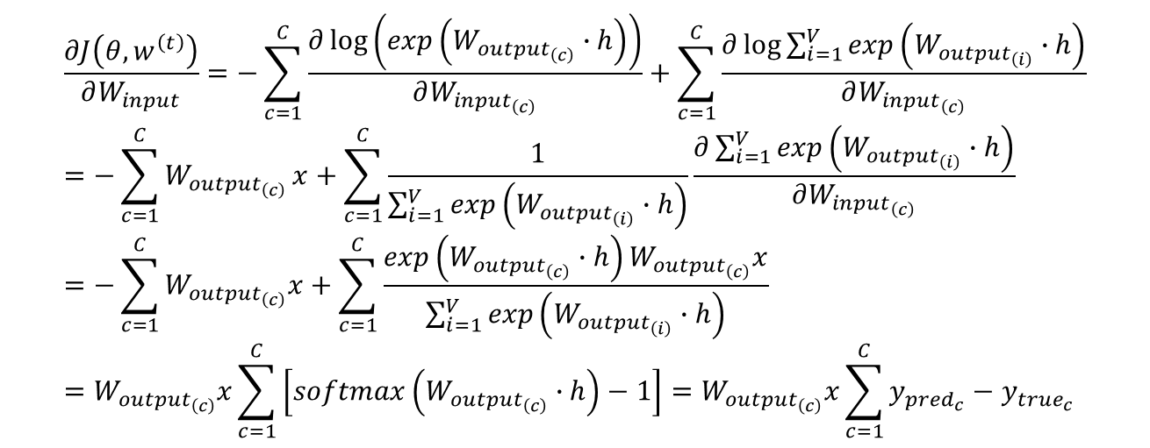
Skip-gram (Backpropagation)
$$\frac{∂J\left(θ,w^{\left(t\right)}\right)}{∂W_{input}}=−\sum_{c=1}^{C}{\frac{∂\log\left(exp\left(W_{{output}_{\left(c\right)}}∙h\right)\right)}{∂W_{{input}_{\left(c\right)}}}}+\sum_{c=1}^{C}{\frac{∂\log{\sum_{i=1}^{V}{exp\left(W_{{output}_{\left(i\right)}}∙h\right)}}}{∂W_{{input}_{\left(c\right)}}}}=−\sum_{c=1}^{C}{W_{{output}_{\left(c\right)}}}x+\sum_{c=1}^{C}{\frac{1}{\sum_{i=1}^{V}{exp\left(W_{{output}_{\left(i\right)}}∙h\right)}}\frac{∂\sum_{i=1}^{V}{exp\left(W_{{output}_{\left(i\right)}}∙h\right)}}{∂W_{{input}_{\left(c\right)}}}}=−\sum_{c=1}^{C}{W_{{output}_{\left(c\right)}}x}+\sum_{c=1}^{C}{\frac{exp\left(W_{{output}_{\left(c\right)}}∙h\right)W_{{output}_{\left(c\right)}}x}{\sum_{i=1}^{V}{exp\left(W_{{output}_{\left(i\right)}}∙h\right)}}}=W_{{output}_{\left(c\right)}}x\sum_{c=1}^{C}{\left[softmax\left(W_{{output}_{\left(c\right)}}∙h\right)−1\right]}=W_{{output}_{\left(c\right)}}x\sum_{c=1}^{C}{y_{{pred}_{c}}−y_{{true}_{c}}}$$

Slide 12
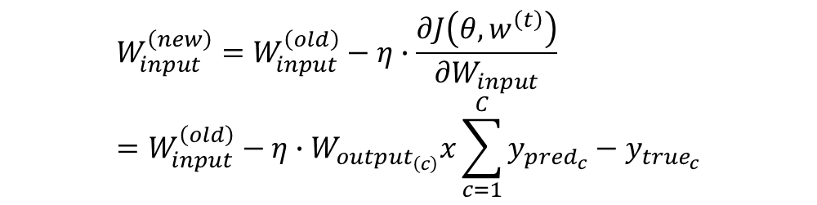
Skip-gram (Backpropagation)
$$W_{input}^{\left(new\right)}=W_{input}^{\left(old\right)}−η∙\frac{∂J\left(θ,w^{\left(t\right)}\right)}{∂W_{input}}=W_{input}^{\left(old\right)}−η∙W_{{output}_{\left(c\right)}}x\sum_{c=1}^{C}{y_{{pred}_{c}}−y_{{true}_{c}}}$$

Slide 13
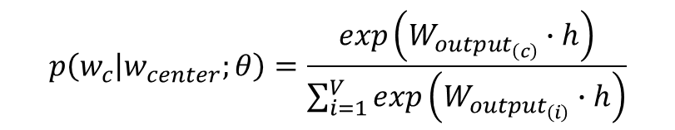
Skip-gram (Softmax problem)
$$p\left(w_{c} | w_{center};θ\right)=\frac{exp\left(W_{{output}_{\left(c\right)}}∙h\right)}{\sum_{i=1}^{V}{exp\left(W_{{output}_{\left(i\right)}}∙h\right)}}$$

Slide 14
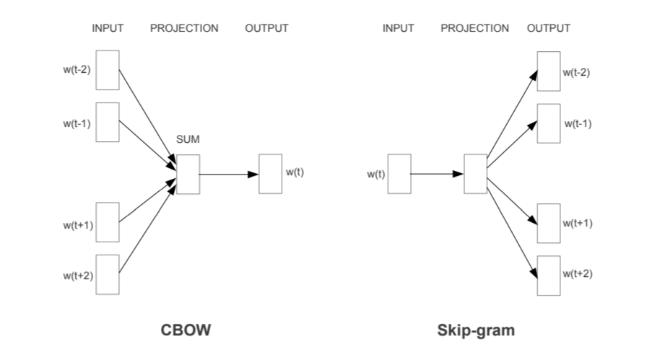
Cbow

Slide 15
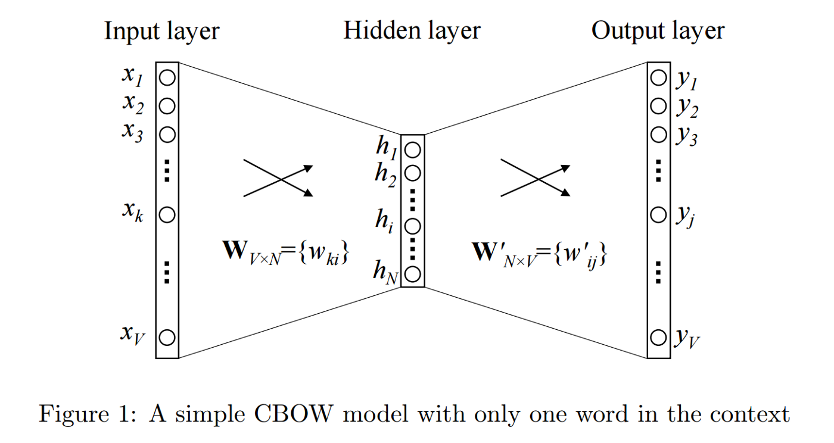
cbow

Slide 16
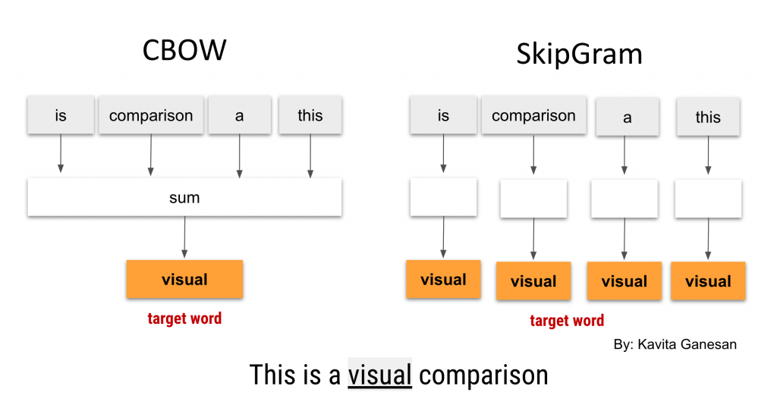
Cbow

Slide 17

Glove

Slide 18
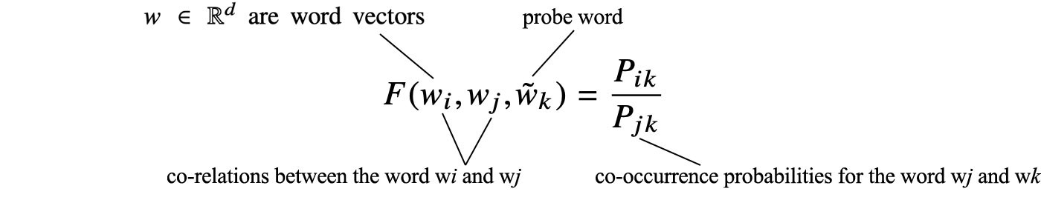
Glove

Slide 19
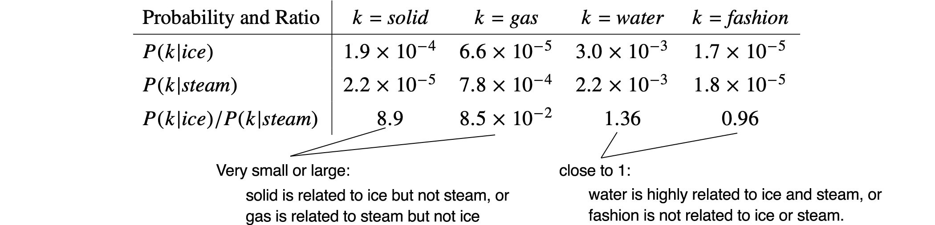

Slide 20


Slide 22
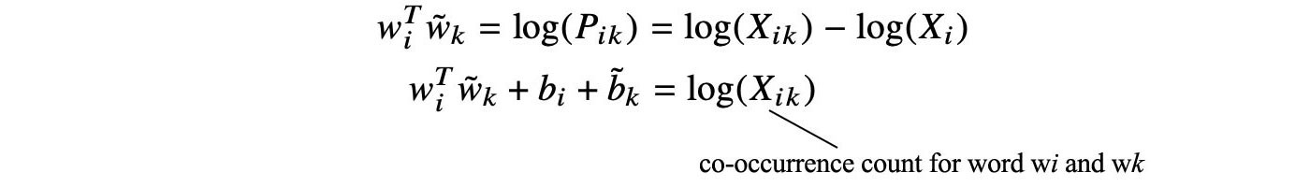

Slide 23

Glove(cost)

Slide 24
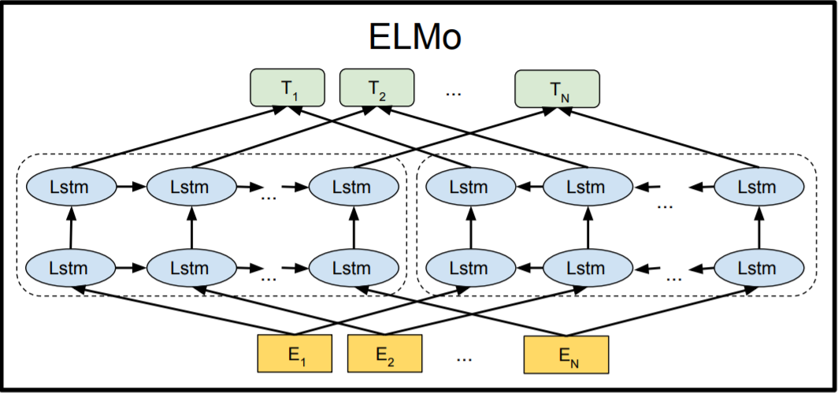
Elmo

Slide 25
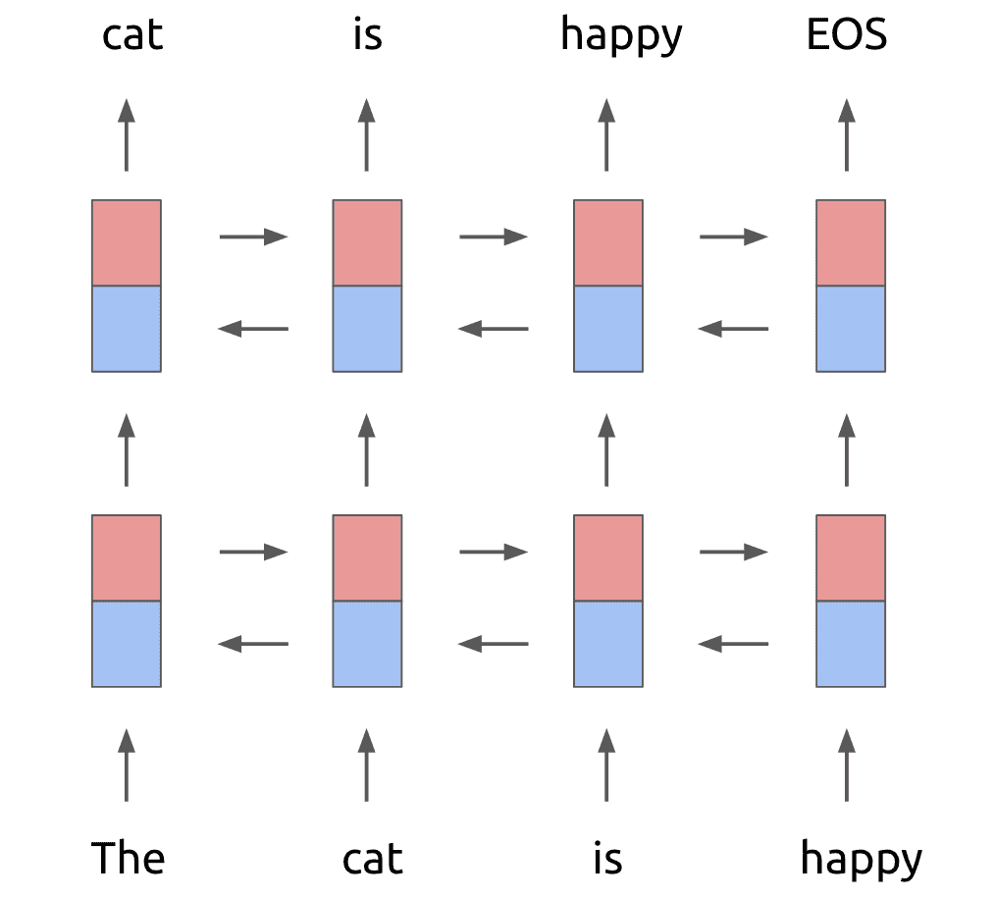
Elmo

Slide 26
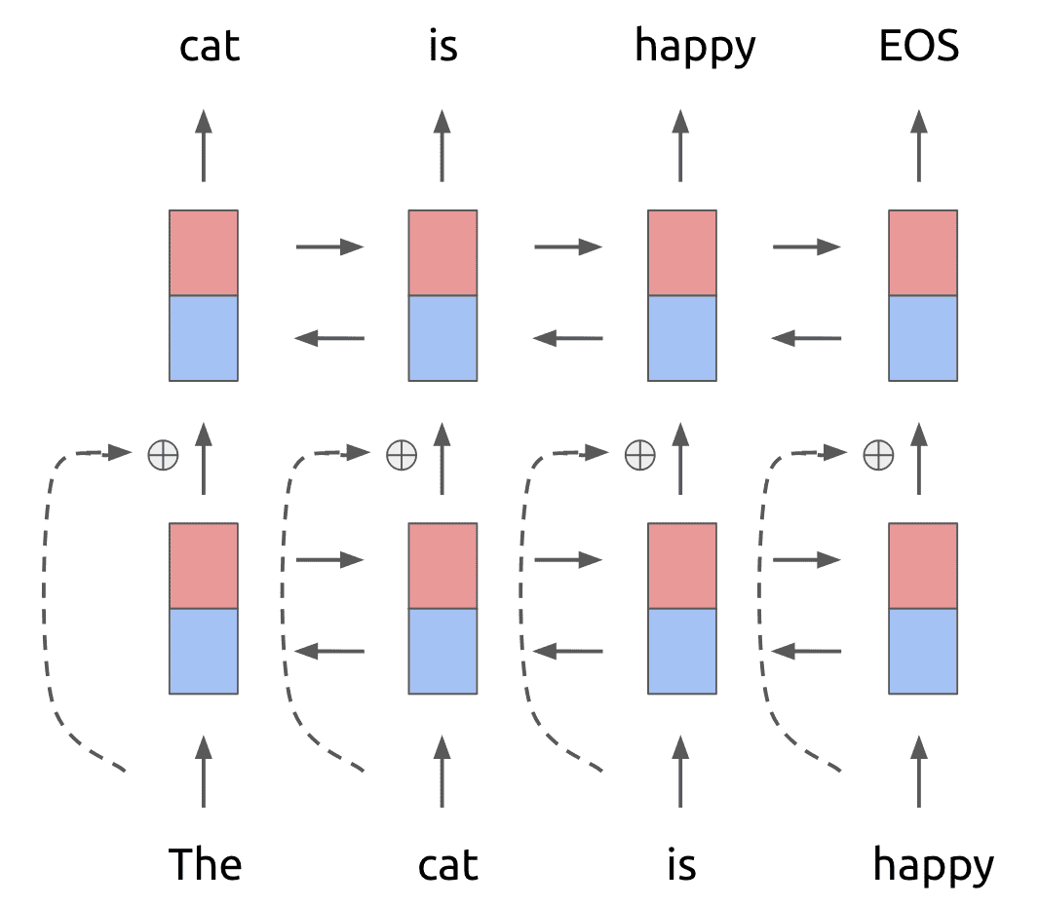

Slide 27
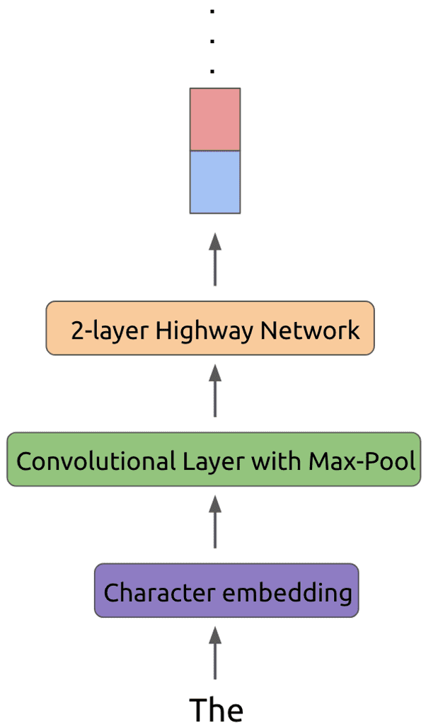

Slide 28
